Slide 1


Enhancing Log Analytics with Generative AI
by Edin Guso
Master Thesis
Prof. Dr. Boi Faltings
Master Project Supervisor
Ketevani Zaridze
In-Company Supervisor
Dr. Virginia Bordignon
External Expert
Notes:
Hello and welcome to my Master’s Thesis defense. My name is Edin Guso, and I will be presenting my thesis: “Enhancing Log Analytics with Generative AI”.

Slide 2
Overview
Introduction
Design
Results
Conclusion

Slide 3
Introduction

Slide 4
Log Data in IT Systems
Importance of Log Data
Diagnosing issues
Understanding behavior
Ensuring security
Log Analysis Challenges
High volume (up to 50 GB per hour) [1]
Redundancy
Diverse formats [2]
Limitations of Traditional Methods
Manual inspection
Domain-specific rules
ICADHT dht-free: Core 1: freeing entry for ACB947BEB2CEFDB2313E1779A01D51
ICADHT dht-free: Core 0: freeing entry for 7E9FA07DAB54AA063F56B14A3393E7
ICADHT dht-free: Core 1: freeing entry for 0223D4DA12830B4C2EFCD4A8DDDA3D
ICADHT dht-free: Core 0: freeing entry for 9D84F28DFE3EB4141A9BF19786378A
ICADHT dht-free: Core 2: freeing entry for E2418358F10DBEB5733F1AC10D966B
[1] Haibo Mi, Huaimin Wang, Yangfan Zhou, Michael Rung-Tsong Lyu, and Hua Cai. “Toward fine-grained, unsupervised, scalable performance diagnosis for production cloud computing systems”. In: IEEE Transactions on Parallel and Distributed Systems 24.6 (2013), pp. 1245–1255.
[2] Andriy Miranskyy, Abdelwahab Hamou-Lhadj, Enzo Cialini, and Alf Larsson. “Operational-log analysis for big data systems: Challenges and solutions”. In: IEEE Software 33.2 (2016), pp. 52–59
Notes:
Logs are records of events that occur within IT systems. Log data is generated by applications, networks, and infrastructure.
---
Due to the limitations of traditional methods, it is very important to develop tools that simplify the log analysis.

Slide 5
Log Analytics Tools
Log Pattern Extraction
Parse and cluster logs into log patterns
Data dimensionality reduction
E.g., Drain [3] maintains a fixed-depth tree to parse log streams
Anomaly Detection
Identify critical log pattern
Models based on BERT [4]
ICADHT dht-free: Core 1: freeing entry for ACB947BEB2CEFDB2313E1779A01D51
ICADHT dht-free: Core 0: freeing entry for 7E9FA07DAB54AA063F56B14A3393E7
ICADHT dht-free: Core 1: freeing entry for 0223D4DA12830B4C2EFCD4A8DDDA3D
ICADHT dht-free: Core 0: freeing entry for 9D84F28DFE3EB4141A9BF19786378A
ICADHT dht-free: Core 2: freeing entry for E2418358F10DBEB5733F1AC10D966B
ICADHT dht-free: Core <*> freeing entry for <*>
Critical / Non-Critical
[3] Pinjia He, Jieming Zhu, Zibin Zheng, and Michael R. Lyu. “Drain: An online log parsing approach with fixed depth tree”. In: 24th International Conference on Web Services (ICWS). IEEE. 2017, pp. 33–40.
[4] Jacob Devlin, Ming-Wei Chang, Kenton Lee, and Kristina Toutanova. “BERT: Pretraining of deep bidirectional transformers for language understanding”. In: Conference of the North American Chapter of the Association for Computational Linguistics: Human Language Technologies. ACL. 2019, pp. 4171–4186.
Notes:
BERT is a deep learning model that uses transformer architecture to understand the context of words in a sentence by looking at them in both directions.

Slide 6
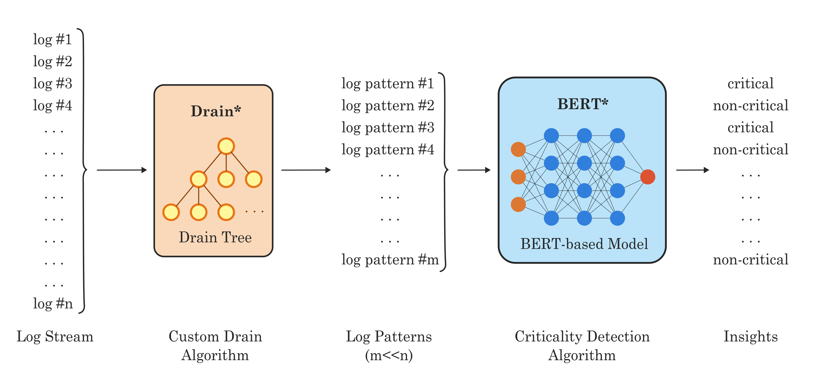
Logmind Pipeline
Notes:
In the market of log analytics, Logmind offers an AI-powered log analytics platform designed for IT operations professionals.

Slide 7
Existing Challenges in Log Analysis
Complex Log Patterns
Requires domain-specific expertise
Query Tool Limitations
Dependent on domain-specific languages
Lack of expressive power
Natural Fit: LLMs
Strong natural language understanding and generation [5]
Broad knowledge from extensive training
Limited exploration of Generative AI in log analytics
Lack of tools for efficient prompt engineering
[5] Yupeng Chang, Xu Wang, Jindong Wang, Yuan Wu, Linyi Yang, Kaijie Zhu, Hao Chen, Xiaoyuan Yi, Cunxiang Wang, Yidong Wang, and et al. “A survey on evaluation of large language models”. In: ACM Transactions on Intelligent Systems and Technology 15.3 (2024), pp. 1–45.

Slide 8
Main Goal
Integrating Generative AI models with traditional log analysis techniques, introducing innovative tools that enhance the accessibility, interpretability, and actionable value of log data.
Notes:
This thesis aims to contribute to the field of log analytics by …

Slide 9
Core Contributions
ModuGPT Framework: Modular framework for LLM-driven tools
Prompt Elements: Structured components for efficient prompting
Insight-to-Text: Transforms log insights into explanations
Text-to-ES: Converts natural language queries to Elasticsearch
SmartSearch: Combines traditional and semantic search
Notes:
ModuGPT: mention langchain and llamaindex: unnecessary layers of abstraction, Unique needs of log analytics, modularity + extensibility

Slide 10
Design

Slide 11
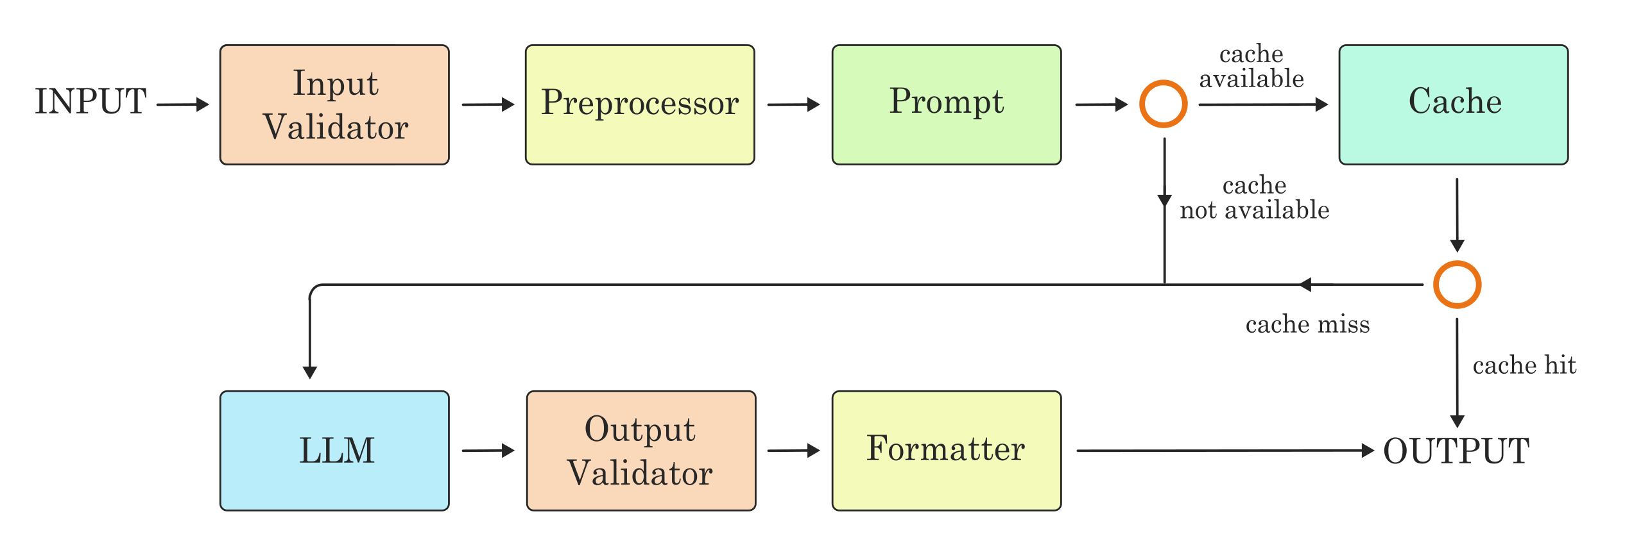
ModuGPT Pipeline

Slide 12
Prompt Engineering
Objective
Craft prompts to optimize LLM responses
Enhance accuracy and relevance of model outputs
Prompt Components
System Messages: Set role and guidelines
User Messages: Input from the user
Assistant Messages: Model-generated responses
Techniques
Zero-shot: No examples provided
Few-shot: Small set of examples guide responses
Prompt Chaining: Breaks complex tasks into simpler steps for better accuracy

Slide 13
Types of Prompt Elements
Persona
Input Description
Task Description
User Profile
Template
Refusal
Rules
Schema
Examples
Default

Slide 14
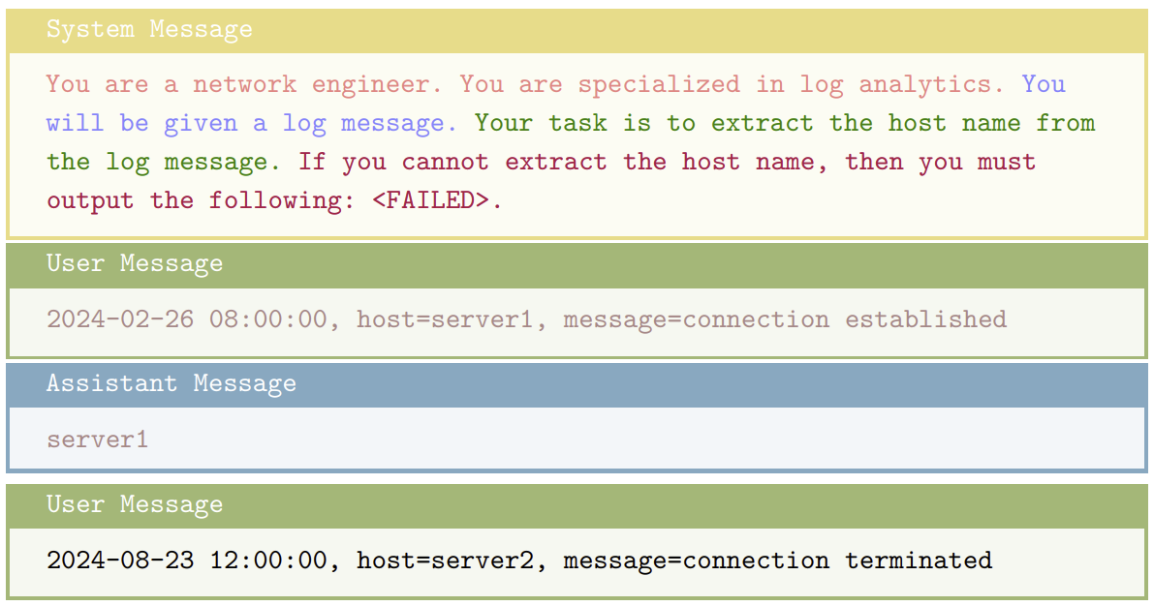
Combining Prompt Elements

Slide 15
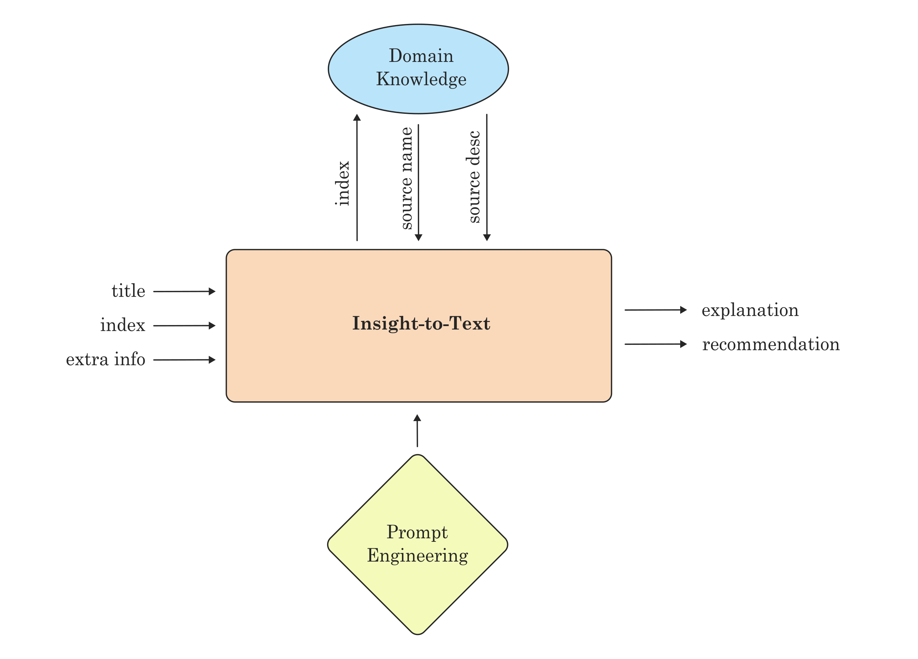
Insight-to-Text

Slide 16
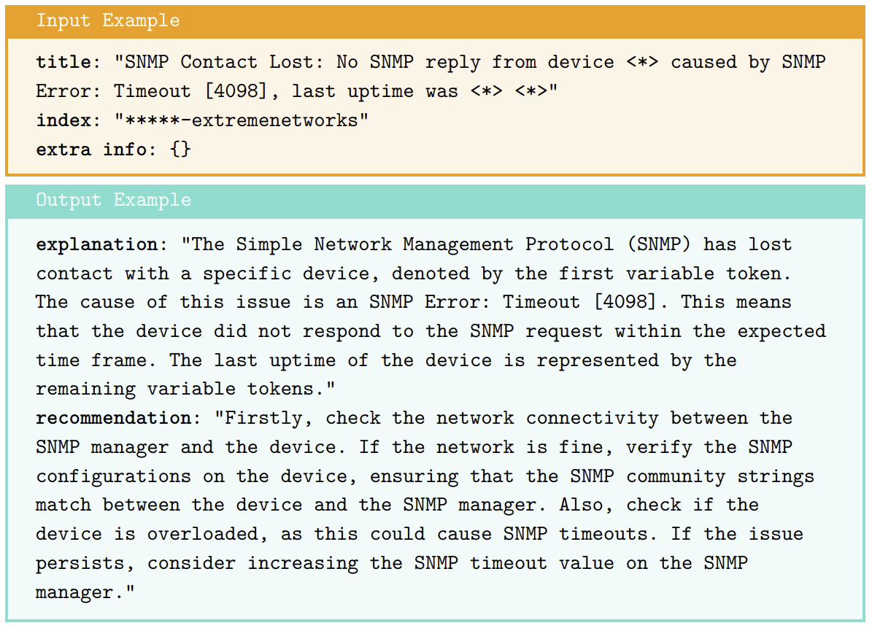
Insight-to-Text Example

Slide 17
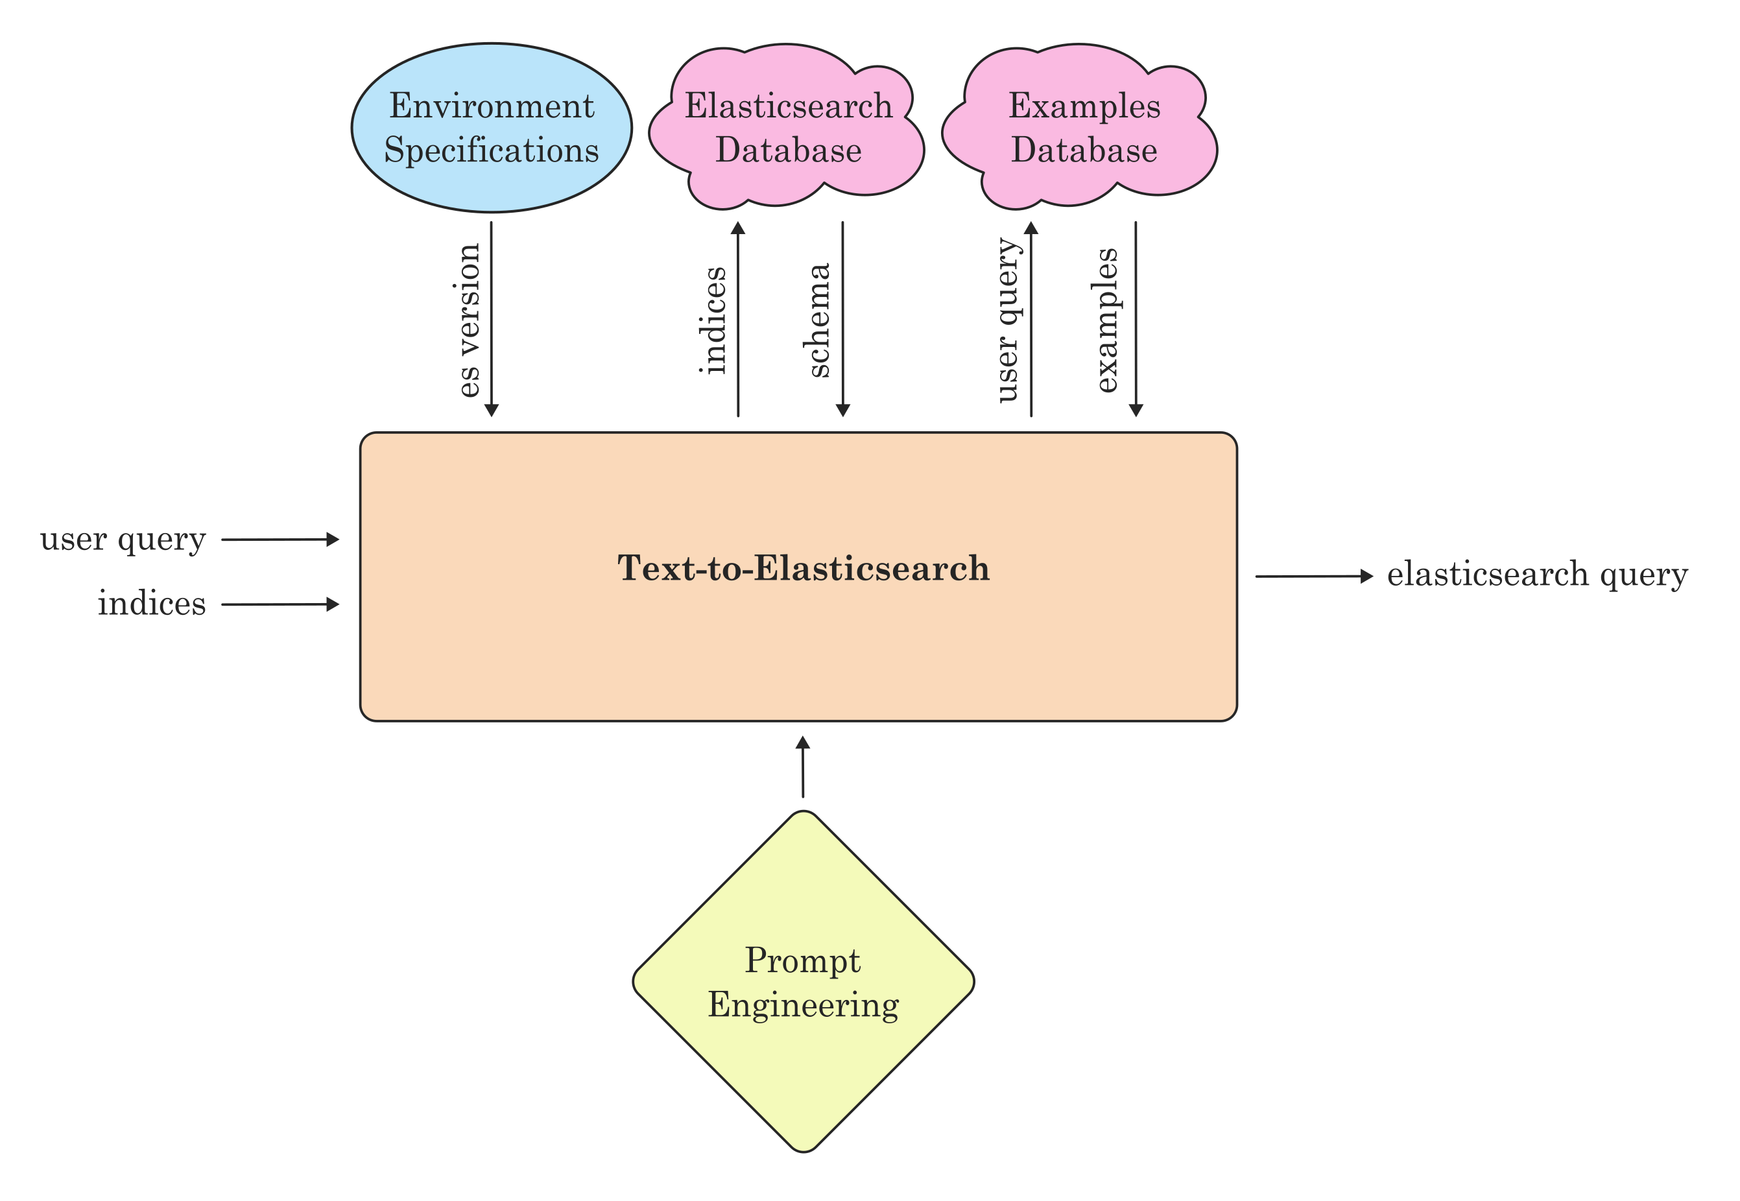
Text-to-ES

Slide 18
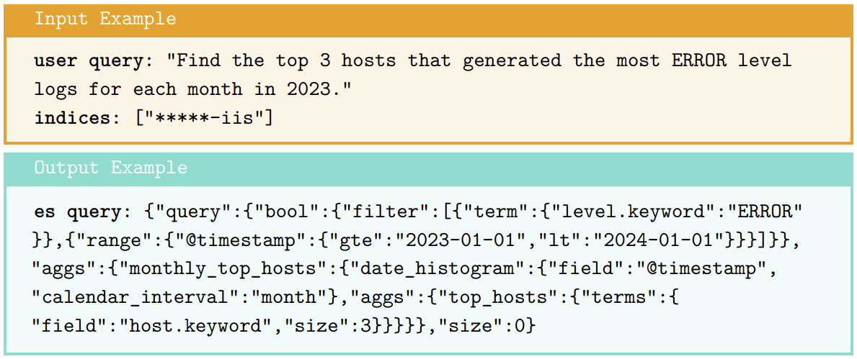
Text-to-ES Example

Slide 19
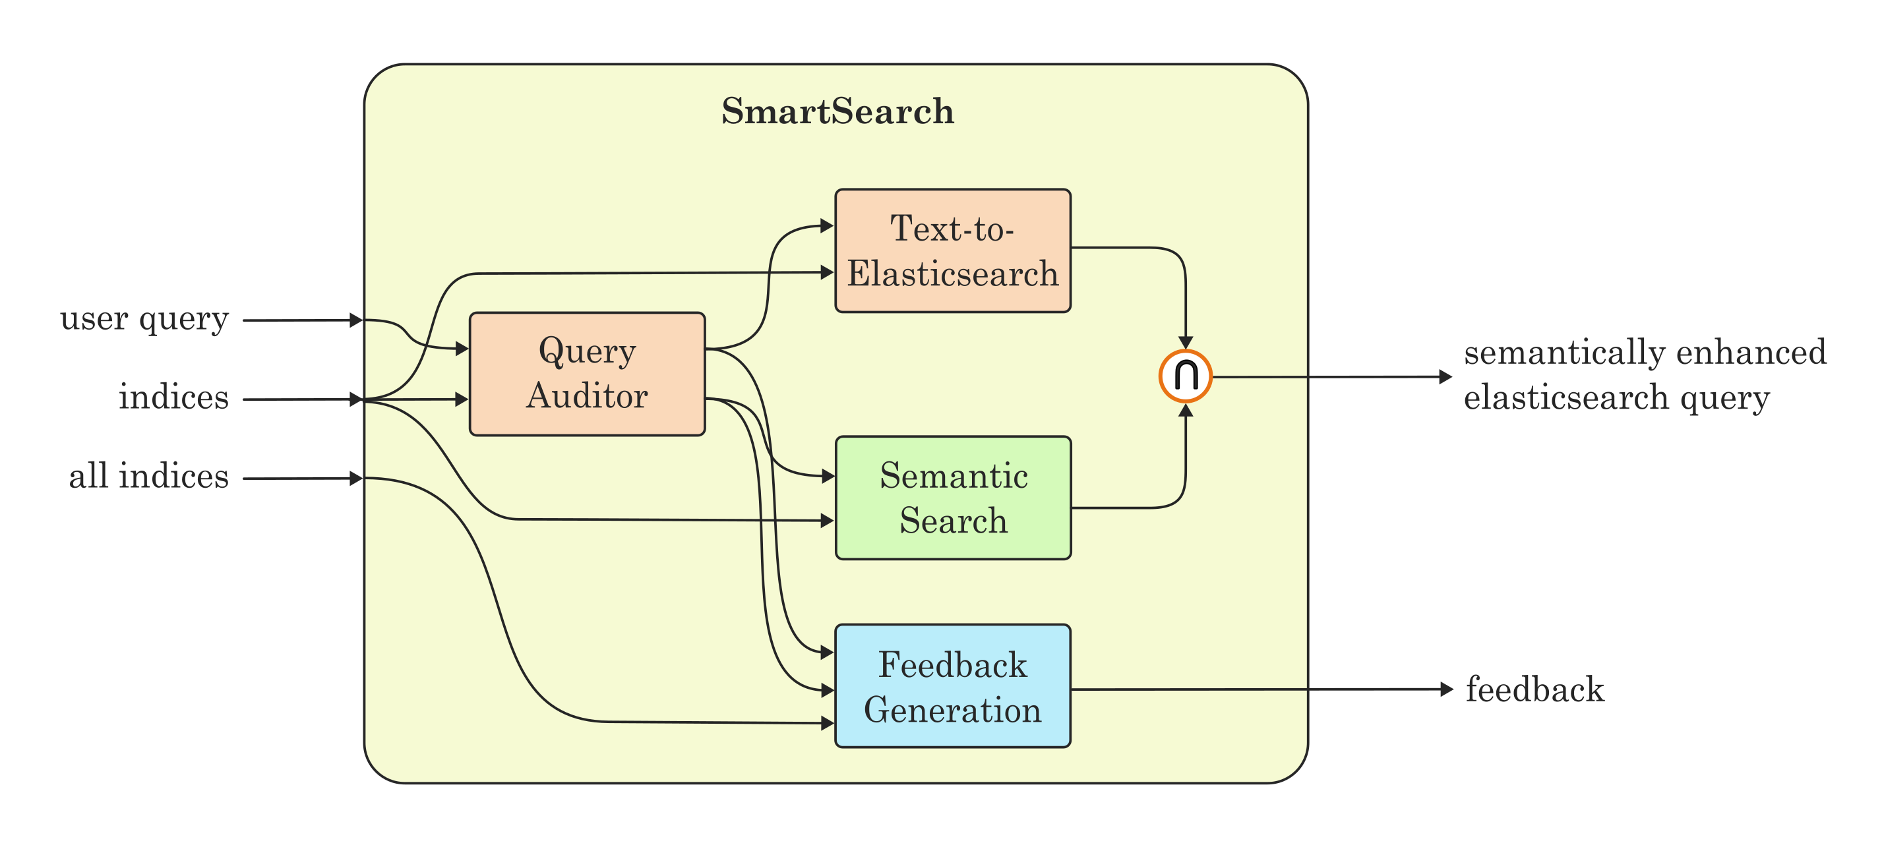
SmartSearch

Slide 20
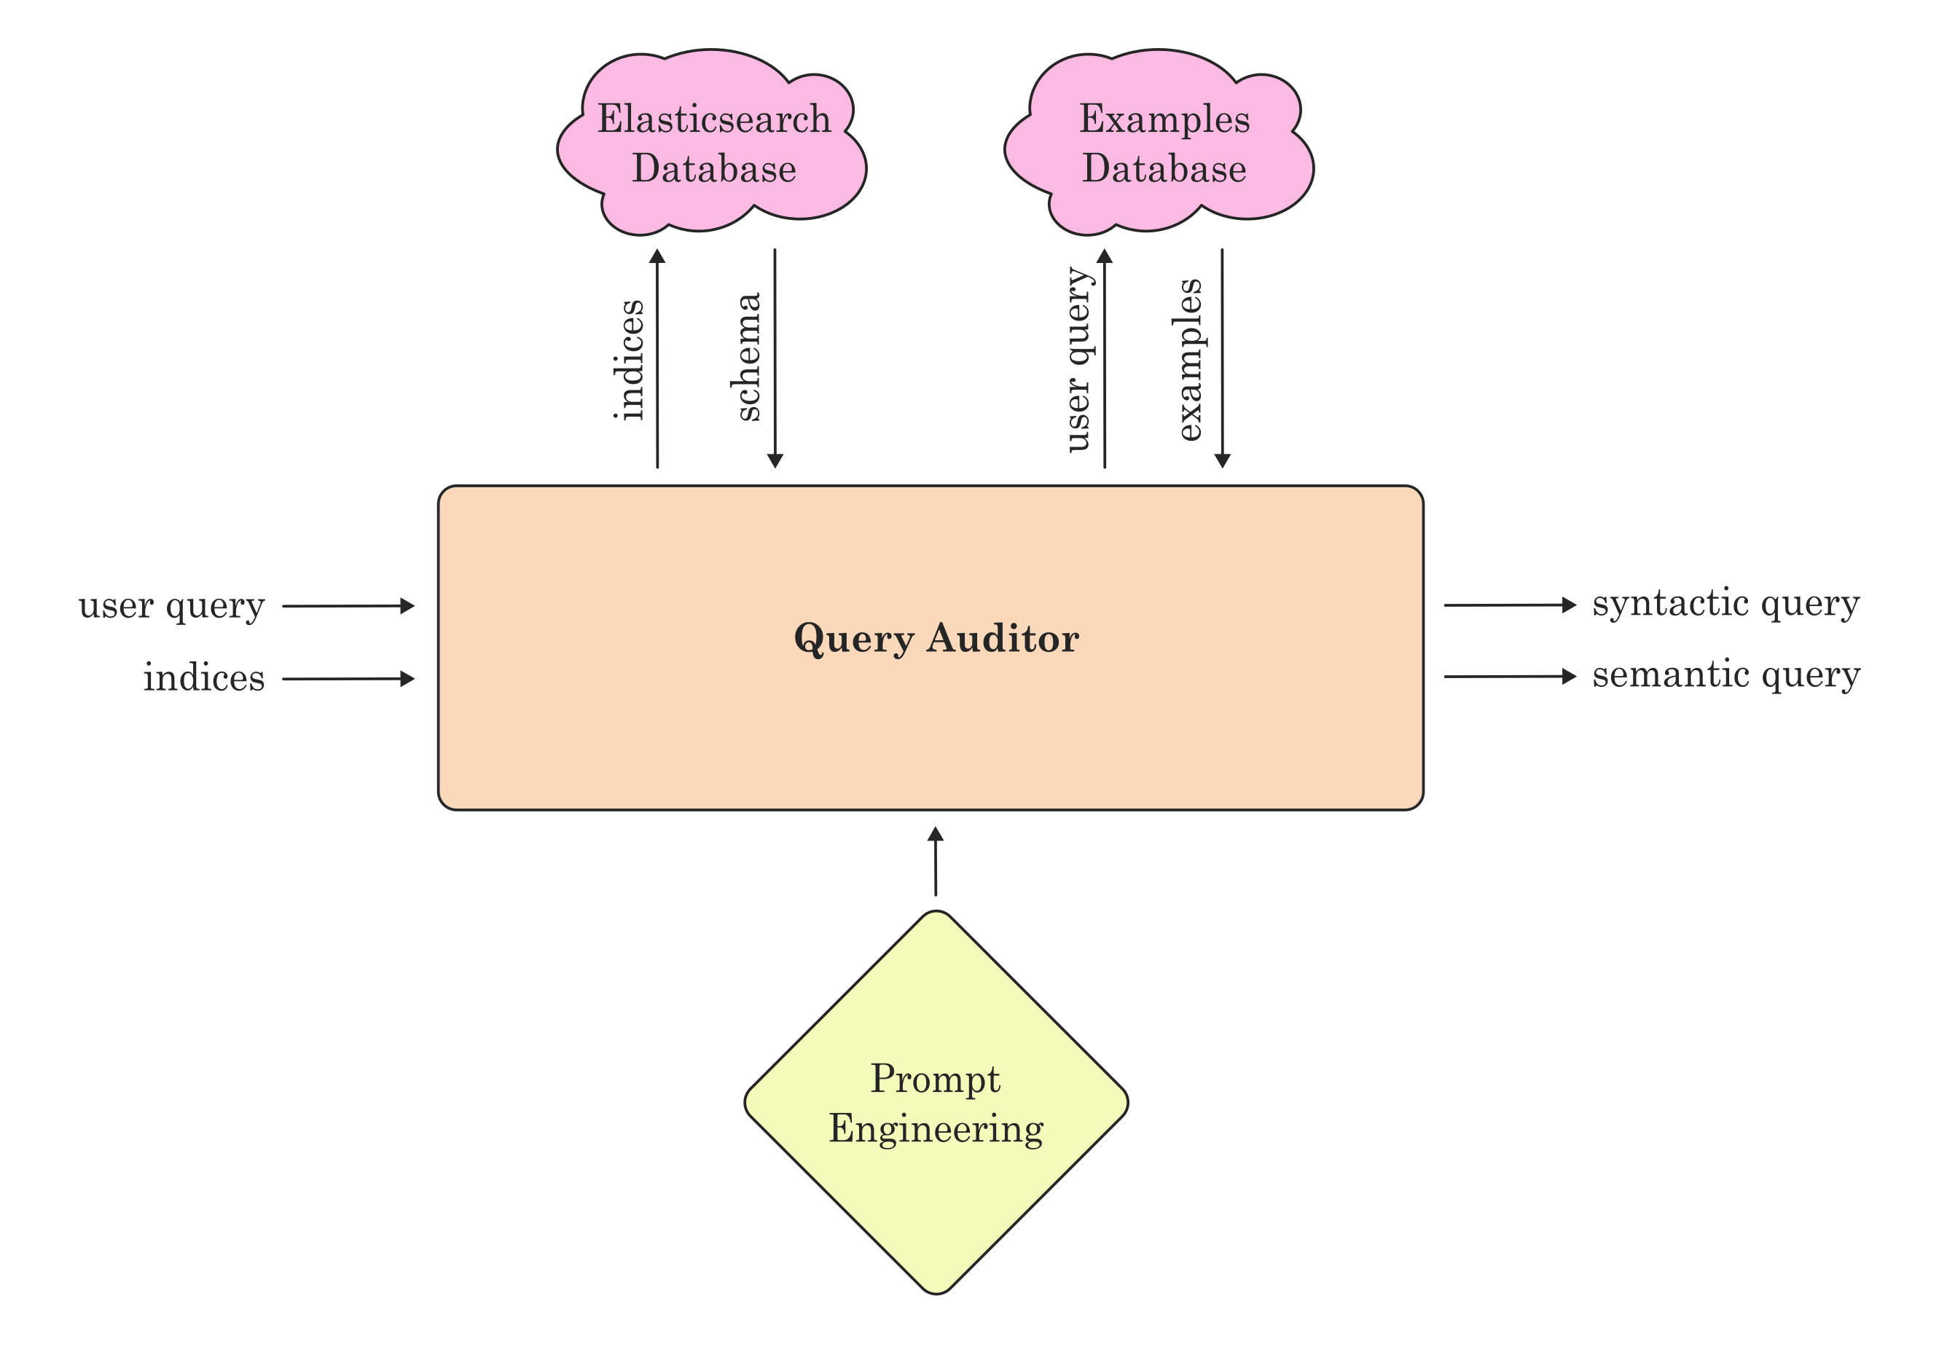
Query Auditor

Slide 21
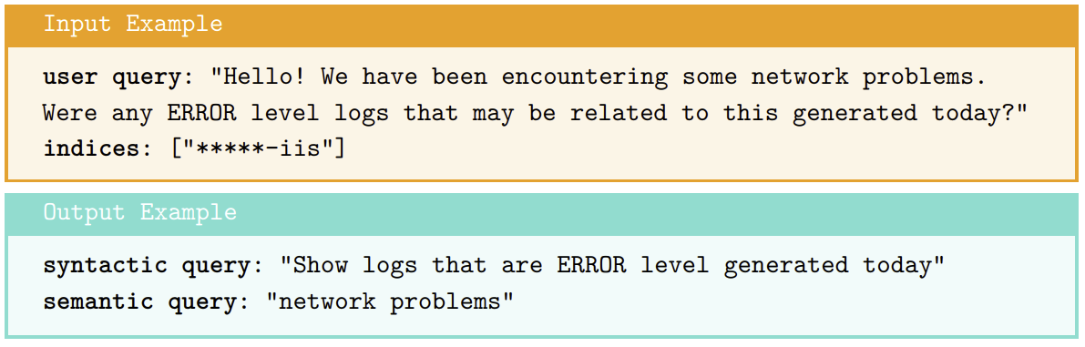
Query Auditor Example

Slide 22
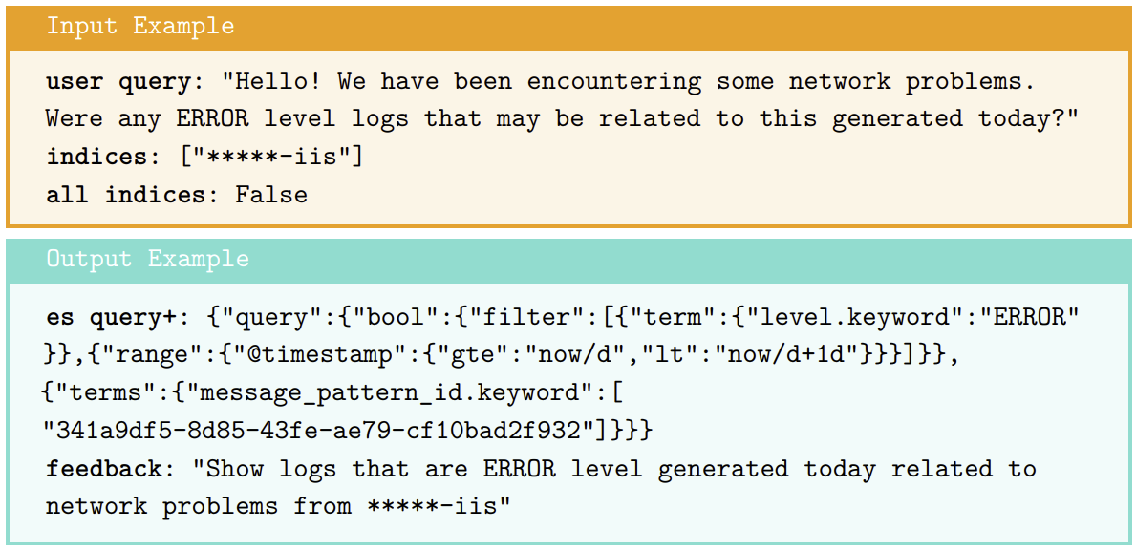
Smart Search Example
HTTP Status: 500 (Internal Server Error) and Win32 Status: 64 (Netname Deleted) on <*>

Slide 23
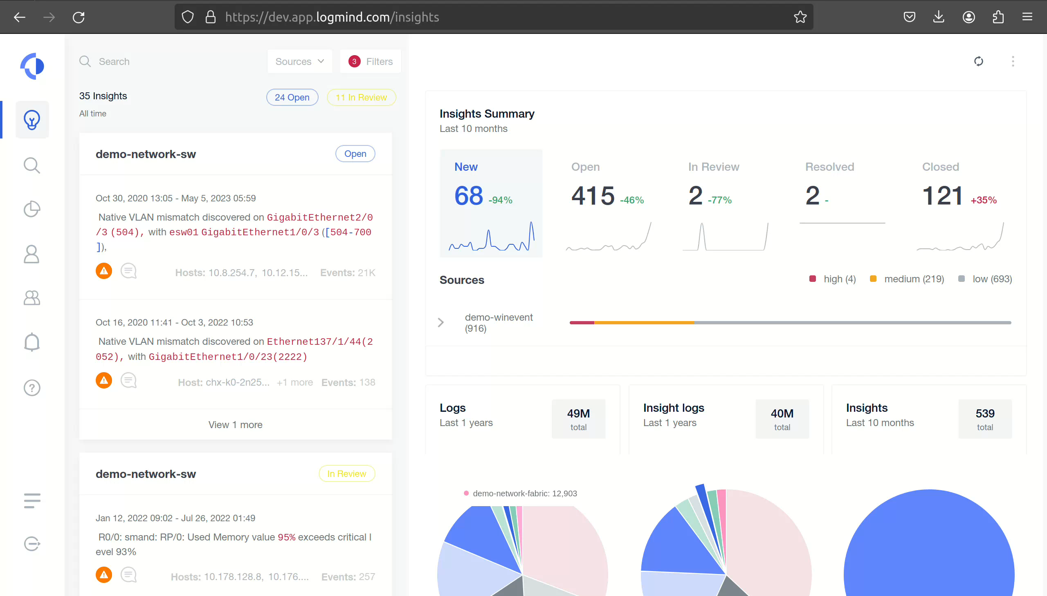

Slide 24
Results

Slide 25
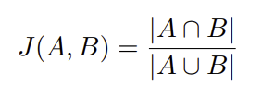
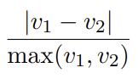
Evaluation Setup
Objective: Assess the effectiveness of developed (eval) agents against control agents
Reference Evaluation
Applied to Text-to-ES and SmartSearch agents
Objectively compare outputs against a golden dataset
Filter and single-level aggregation queries
SetSimilarityMetric and QuerySimilarityMetric
A/B Testing
Used for Insight-to-Text tool
LLM-as-a-judge evaluates quality of outputs
Important to address biases like model preference [6] and positional bias [7]
Repeated runs of the judge LLM with non-zero temperature
Diverse Dataset
[6] Yang Liu, Dan Iter, Yichong Xu, Shuohang Wang, Ruochen Xu, and Chenguang Zhu. “G-EVAL: NLG evaluation using GPT-4 with better human alignment”. In: arXiv preprint arXiv:2303.16634 (2023).
[7] Peiyi Wang, Lei Li, Liang Chen, Zefan Cai, Dawei Zhu, Binghuai Lin, Yunbo Cao, Qi Liu, Tianyu Liu, and Zhifang Sui. “Large language models are not fair evaluators”. In: arXiv preprint arXiv:2305.17926 (2023).
Notes:
Network Firewalls, Windows Events, Networking, Java apps, and Web Servers

Slide 26

Insight-to-Text Results
Judge LLM scores both the eval and control output between 1 and 5
Every output is evaluated 10 times, and the grades are averaged
Notes:
Compared to no prompt engineering

Slide 27
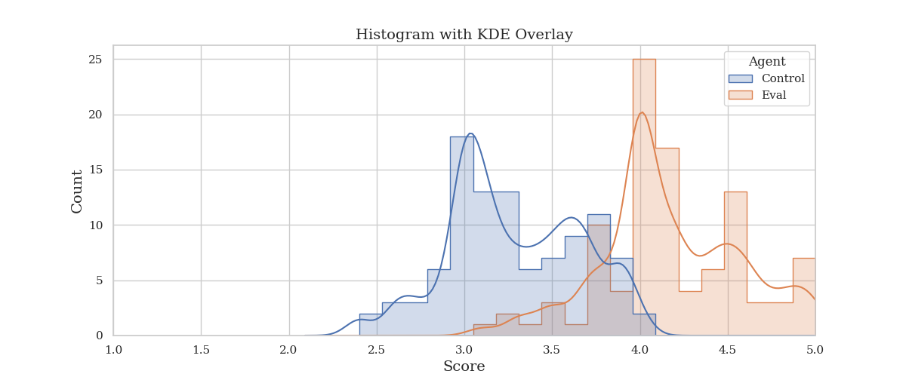
Insight-to-Text Results
Judge LLM scores both the eval and control output between 1 and 5
Every output is evaluated 10 times, and the grades are averaged

Slide 28
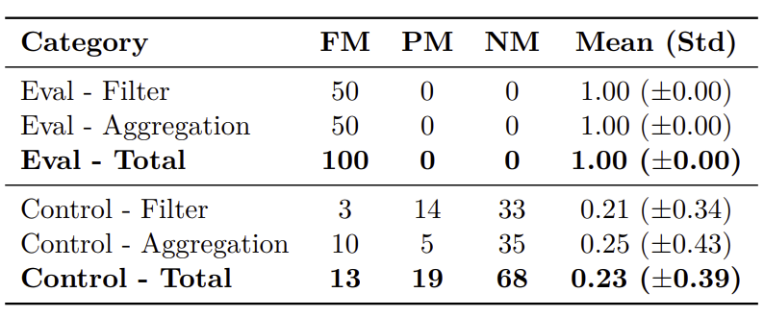
Text-to-ES Results
Score is the similarity between the golden query results and generated query results
FM: Full match; PM: Partial match; NM: No match
Notes:
Compared to no prompt engineering

Slide 29
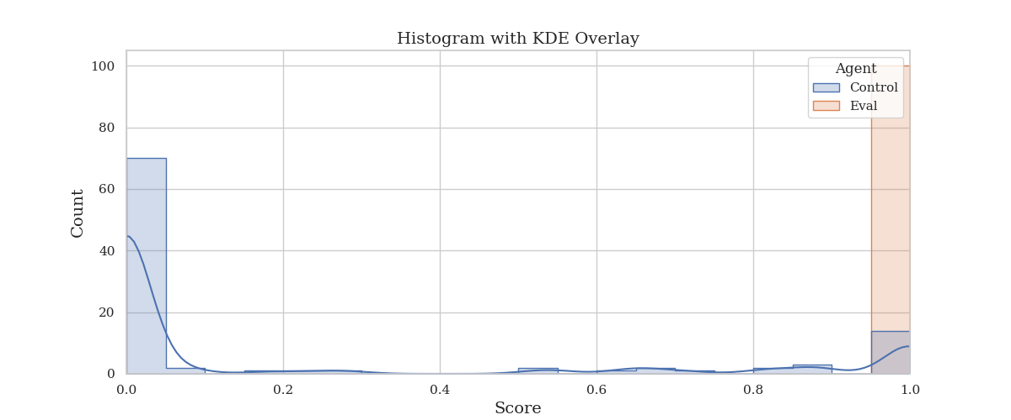
Text-to-ES Results
Score is the similarity between the golden query results and generated query results

Slide 30
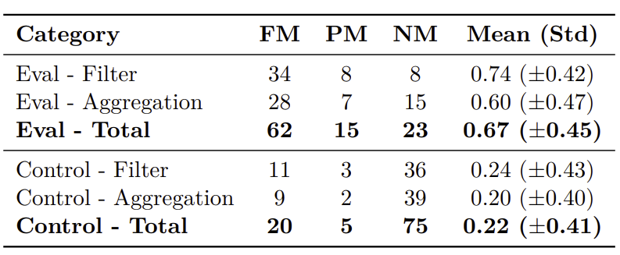
SmartSearch (Syntactic Part) Evaluation
Score is the similarity between the golden query results and generated query results
FM: Full match; PM: Partial match; NM: No match
Notes:
Compared to no prompt chaining

Slide 31
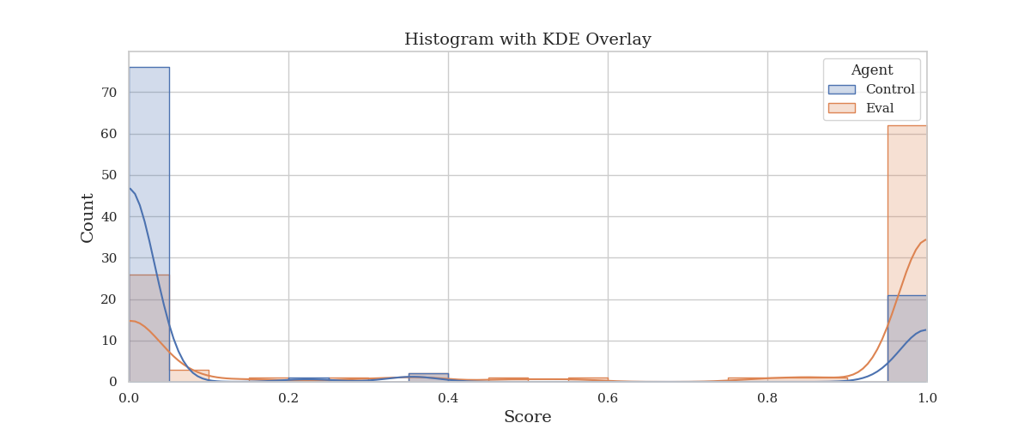
SmartSearch (Syntactic Part) Evaluation
Score is the similarity between the golden query results and generated query results

Slide 32

SmartSearch (Semantic Part) Evaluation
Score is the similarity between the golden patterns and generated patterns
FM: Full match; PM: Partial match; NM: No match
Notes:
Compared to no prompt chaining

Slide 33
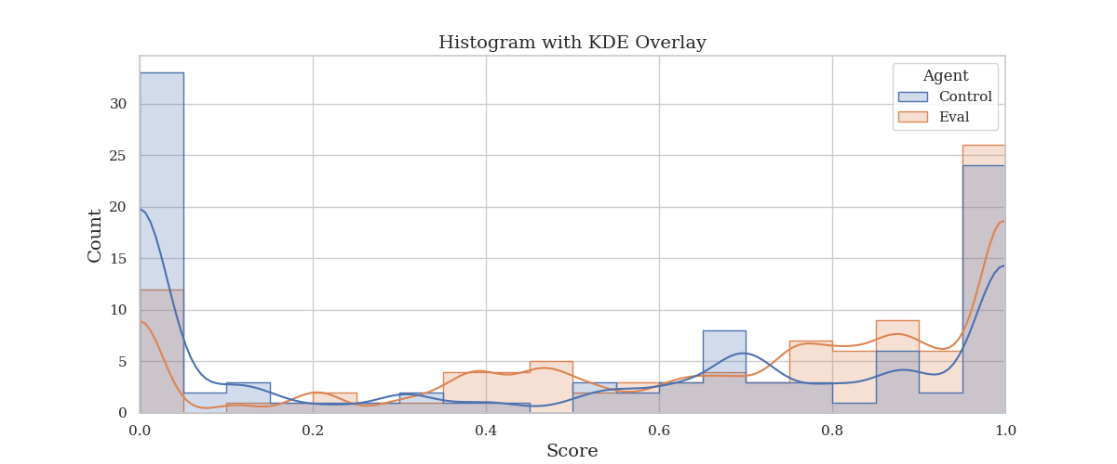
SmartSearch (Semantic Part) Evaluation
Score is the similarity between the golden patterns and generated patterns

Slide 34
Conclusion

Slide 35
Conclusion
Key Contributions
ModuGPT Framework: Modular framework for LLM-driven tools
Prompt Elements: Structured components for efficient prompting
Insight-to-Text: Transforms log insights into explanations
Text-to-ES: Converts natural language queries to Elasticsearch
SmartSearch: Combines traditional and semantic search
Impact
Address the complexity and volume challenges in modern IT systems
More accessible, interpretable, and actionable log analytics
Future Work
Ablation Studies
Fine-Tuning
Notes:
!!! This thesis showcases the potential of Generative AI in log analytics

Slide 36
Appendix

Slide 37
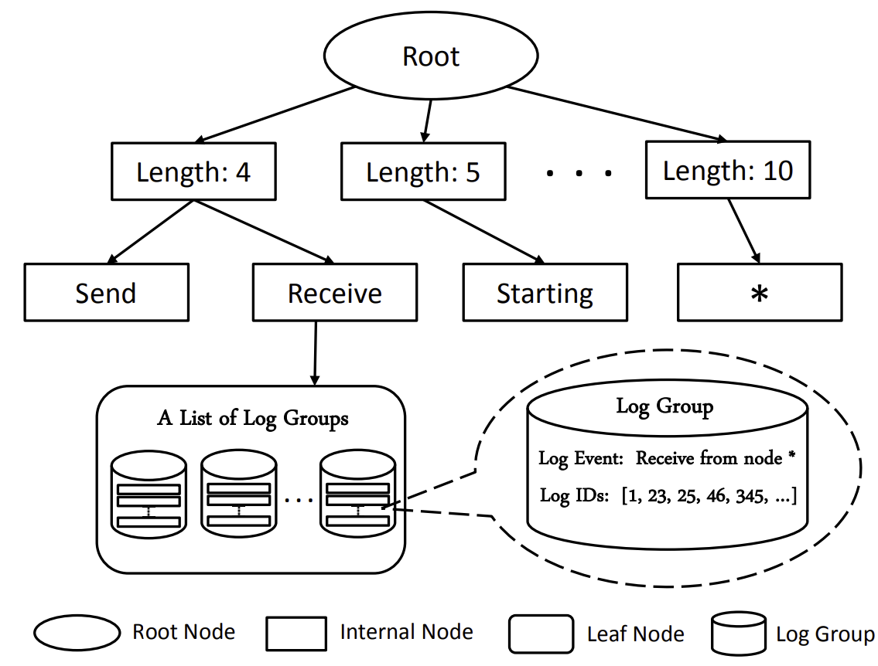
Drain [3]
Objective: Efficient online log parsing
Fixed Depth Tree
Quick log categorization
Structured event creation
Preprocessing
Simple regex to remove variables
Token-Based Search
Based on log length and leading tokens
Performance
High accuracy
Up to 81% faster than other parsers
[3] Pinjia He, Jieming Zhu, Zibin Zheng, and Michael R. Lyu. “Drain: An online log parsing approach with fixed depth tree”. In: 24th International Conference on Web Services (ICWS). IEEE. 2017, pp. 33–40.

Slide 38
BERT [4]
Objective: Pre-train deep bidirectional representations for NLP tasks
Architecture
Bidirectional Transformer: Jointly attends to left and right context
Masked Language Model (MLM): Predicts masked tokens based on full context
Next Sentence Prediction (NSP): Trains on sentence pairs to capture relationships
Key Features
Unified model for various NLP tasks
State-of-the-art performance across multiple benchmarks
[4] Jacob Devlin, Ming-Wei Chang, Kenton Lee, and Kristina Toutanova. “BERT: Pretraining of deep bidirectional transformers for language understanding”. In: Conference of the North American Chapter of the Association for Computational Linguistics: Human Language Technologies. ACL. 2019, pp. 4171–4186.

Slide 39
Large Language Models (LLMs)
AI Context
Generative AI using Deep Learning
Powers human-like natural language understanding (NLU) and generation (NLG)
Key Tech
Transformers [8]: Enable efficient long-range text processing
Enhancements
RLHF [9]: Fine-tunes LLMs to align with human preferences
[8] Ashish Vaswani, Noam Shazeer, Niki Parmar, Jakob Uszkoreit, Llion Jones, Aidan N Gomez, Łukasz Kaiser, and Illia Polosukhin. “Attention is all you need”. In: Advances in neural information processing systems 30 (2017), pp. 5998–6008.
[9] Paul F Christiano, Jan Leike, Tom B Brown, Miljan Martic, Shane Legg, and Dario Amodei. “Deep reinforcement learning from human preferences”. In: Advances in Neural Information Processing Systems 30 (2017), pp. 4302–4310.

Slide 40
Semantic Search
Objective
Enhance search relevance by understanding text meaning, not just keywords
Key Concepts
Embedding Models: Convert text into high-dimensional vectors capturing semantic meaning
Semantic Connections: Recognizes related concepts, e.g., "network failure" and "connectivity issues"
Tools
Vector Databases: Store and efficiently search embeddings to find semantically similar documents

Slide 41
Terminology
DriverAgent: Orchestrates the ModuGPT pipeline
Module: Performs specific tasks within DriverAgent
CustomAgent: Executes complex, multi-step operations
Tool: Blueprint for creating ModuGPT agents
Prompt Element: Reusable component for constructing prompts

Slide 42
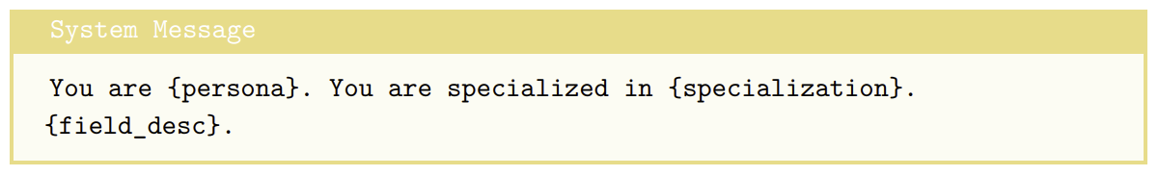
Persona Prompt Element

Slide 43
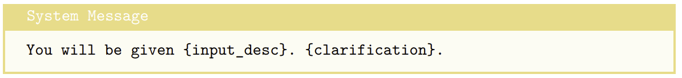
Input Description Prompt Element

Slide 44
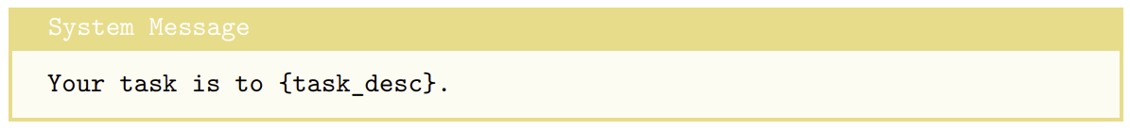
Task Description Prompt Element

Slide 45
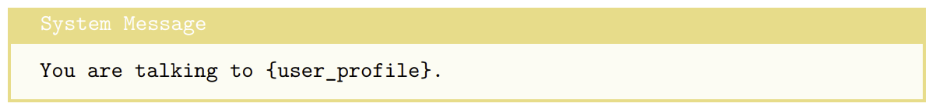
User Profile Prompt Element

Slide 46
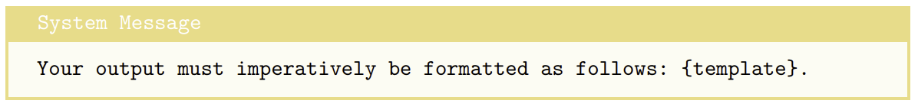
Template Prompt Element

Slide 47
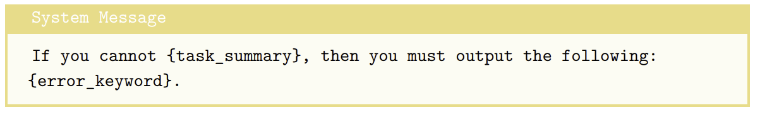
Refusal Prompt Element

Slide 48
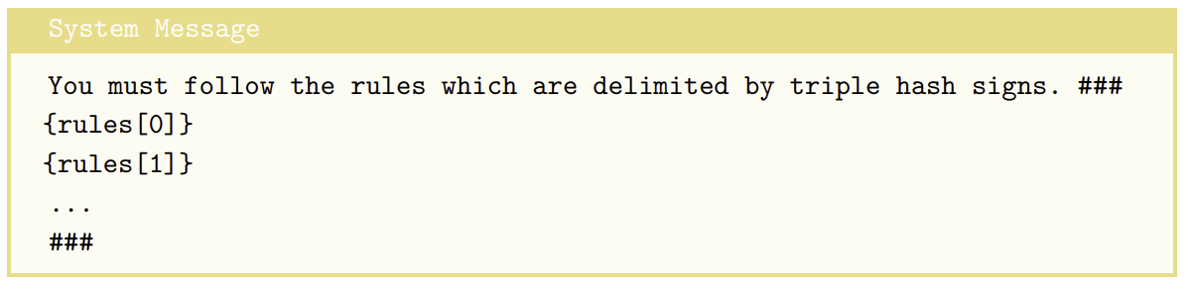
Rules Prompt Element

Slide 49
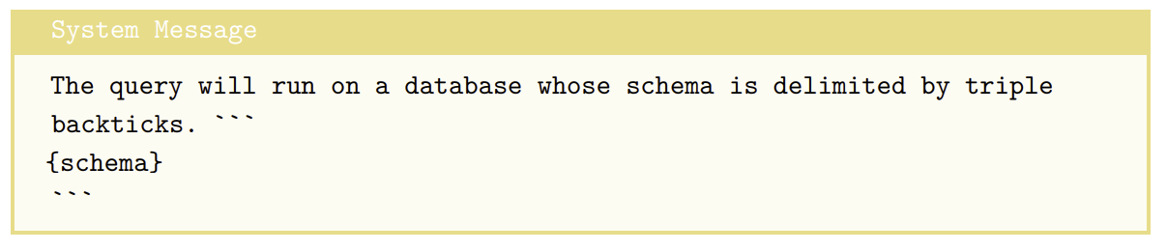
Schema Prompt Element

Slide 50
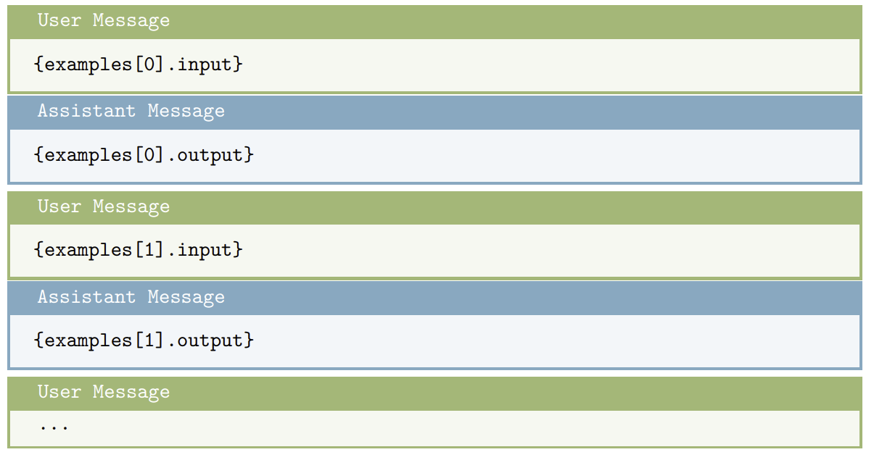
Examples Prompt Element

Slide 51
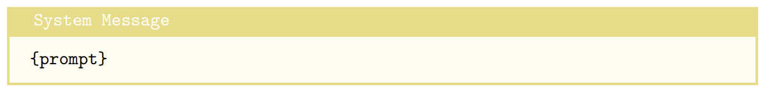
Default Prompt Element

Slide 52
Development Environment
Programming Language: Python
Strong support for GenAI applications
Sufficient performance
Alignment with Logmind’s existing technology stack
Framework: Why ModuGPT?
Unnecessary layers of abstraction in other frameworks
Unique needs of log analytics
Modularity and extensibility
Choice of LLMs
gpt-3.5-turbo-instruct
gpt-4o-mini
gpt-4o (evaluation)
Open-source Library

